Slide 1
Regional Strategic Partnership Fund (RSPF)
RSPF Impacts Report
March 2026

Slide 2
About the Regional Strategic Partnership Fund
In May 2021, the New Zealand government announced the Regional Strategic Partnership Fund (RSPF), allocating $193.8 million to Kānoa – Regional Economic Development & Investment Unit to support regions to make steps towards achieving their economic potential.
The RSPF allocated funding in these streams:
  Enabling regional economic and business development - $40.5 million
  Accelerating Māori economic aspirations - $61.5 million
  Supporting sector transformations - $51.7 million
  Emerging priorities - $40.1 million
The RSPF was fully allocated as of 23 August 2023 and $140 million has so far been paid out in grants ($19m), loans ($112m) or equity ($9m). Kānoa continues to monitor and administrate investments as they move through their life cycles.

Slide 3
About RSPF Impacts Reporting
To collect the data to monitor impacts, Kānoa has recipients complete RSPF Impacts Reports online every six months after they first receive funds, reporting on the impacts they experienced in that six months as a result of RSPF funding.¹
The questions on impacts are grouped by five areas that support RSPF outcomes. These areas are:
  Innovation – 3 questions
  Business capability (including Māori business identification) – 11 questions
  Networks – 3 questions
  Staff – 6 questions
  Environment – 6 questions.
This paper reports on the results of the impact data monitoring. The analysis covers all responses received since reporting began in June 2023, up to the current reporting month. ²
¹ RSPF Impacts Reporting is in addition to reporting recipients do so that Kānoa can assess risks and monitor the progress of projects invested in.
² Impacts may occur at any time in the life cycle of an investment and only need to occur once to be counted.

Slide 4
RSPF Impacts Reporting
Results to 31 March 2026
By impact area

Slide 5
RSPF Impacts Reporting
Results to 31 March 2026
Results overall
Overall RSPF funding has contributed to regions achieving their economic potential
It has done this through the impacts funded organisations have had as a result of RSPF funding. These include impacts on:
Innovation
RSPF funding increased product diversity for 91% of firms reporting impacts, R&D spending for 65%, and the adoption and introduction of new technology for 71% - all factors crucial to innovation that increases productivity.
Business capability
RSPF funding increased future planning for 97% of organisations reporting impacts, alignment with community values for 97%, productive capacity for 88%, capital spending for 85%, and access to non-RSPF funding for 71%. These factors strengthen social capital, physical capital, and access to financial capital, contributing to a stronger base for economic growth.
Nearly all of the organisations also employed more services from local businesses as a result of RSPF funding, and 41% were Māori businesses.

Slide 6
RSPF Impacts Reporting
Results to 31 March 2026
Results overall
Overall RSPF funding has contributed to regions achieving their economic potential
Networks
RSPF funding strengthened relationships for 97% of organisations reporting impacts, benefited other organisations indirectly for 97% and resulted in more skilled workers in the region for 82% suggesting spillover benefits to the wider region that result in a multiplier effect, increasing the total economic benefits.
Staff
RSPF funding increased staff motivation for 85% of organisations reporting impacts, supported the local community for 82%, upskilled staff for 79%, and increased staff wellbeing for 65%, which all have benefits for greater wellbeing in the community and increased productive potential.
Environment
RSPF funding helped organisations reporting impacts to reduce greenhouse gas emissions for 65%, improve water efficiency for 50%, protect biodiversity for 38%, and reduce waste for 35%. These practices help achieve environmental sustainability for sustainable regional economic growth.

Slide 7


RSPF Impacts Reporting
Results to 31 March 2026
Number of responses
34
organisations have completed at least one RSPF Impacts Report
39
organisations have received funding and are eligible for RSPF impacts reporting ¹
2
organisations are contracted but are not yet eligible for RSPF impacts reporting ¹
¹ Organisations begin RSPF impacts reporting six months after they have received their first payment.

Slide 8
RSPF Impacts Reporting
Results to 31 March 2026
Results by impact area
Innovation as a result of RSPF funding
of the 34 reporting organisations
31 (91%)
increased their product diversity. 26 (76%) increased it substantially.
22 (65%)
increased their spending on research or development. 7 (21%) increased it substantially.
24 (71%)
adopted or developed new technology. Automation/Mechanisation was the most common technology.

Slide 9
RSPF Impacts Reporting
Results to 31 March 2026
Results by impact area
Business capability 1:2 as a result of RSPF funding
33 (97%)
undertook future planning.
33 (97%)
increased their alignment with community values. 23 (68%) increased it substantially.
30 (88%)
expanded their capacity to produce more. 20 (59%) increased it substantially.
29 (85%)
increased their capital spending. 20 (59%) increased it substantially.
24 (71%)
found it easier to access funding from other, non-RSPF sources. 9 (26%) found it substantially easier.
16 (47%)
increased their profit margins. 5 (15%) increased them substantially, but 4 (12%) saw them decrease.
2.46 million
square metres of land was brought into sustainable production.

Slide 10
RSPF Impacts Reporting
Results to 31 March 2026
Results by impact area
Business capability 2:2 as a result of RSPF funding
33 (97%)
employed more of the services of local businesses.
20 (59%)
employed more of the services of Māori businesses.
14 (41%)
identified as a Māori business and had owners who whakapapa to Māori.¹
¹ According to StatsNZ’s definition, an organisation must identify as a Māori business, and have owners that whakapapa to Māori, to be classed officially as a Māori business.

Slide 11
RSPF Impacts Reporting
Results to 31 March 2026
Results by impact area
Networks as a result of RSPF funding
33 (97%)
strengthened relationships with other public, private or community organisations. 21 (62%) strengthened them substantially.
33 (97%)
benefited other organisations indirectly (other than in direct commercial transactions).
28 (82%)
reported more skilled workers in their region.

Slide 12
RSPF Impacts Reporting
Results to 31 March 2026
Results by impact area
Staff as a result of RSPF funding
29 (85%)
increased staff motivation. 19 (56%) increased it substantially.
28 (82%)
increased their support for the local community. 14 (41%) increased it substantially.
27 (79%)
trained or upskilled staff. 9 (26%) trained or upskilled all their staff.
22 (65%)
increased staff wellbeing. 8 (24%) increased it substantially.
869 workers
were employed. 716 (82%) were full-time; 153 (18%) were part-time. ¹
85% local
workers were employed.
¹ Sum of workers over the whole period of reporting (i.e. all months)

Slide 13
RSPF Impacts Reporting
Results to 31 March 2026
Results by impact area
Environment as a result of RSPF funding
22 (65%)
took steps to reduce greenhouse gas emissions. Reduced waste and planted trees were the most common steps.
17 (50%)
improved their water efficiency. Mainly by encouraging water conservation, measuring water use, and recycling wastewater.
13 (38%)
took steps to protect or enhance biodiversity. Primarily by planting native plants and eliminating invasive plants and animal species.
12 (35%)
reduced waste. Mostly by composting, recycling or reusing.
24 (71%)
developed or started to implement a climate change mitigation-adaptation plan.
32 (94%)
faced challenges in developing a climate change mitigation-adaptation plan. The most common challenge was the time needed, followed by the expense.

Slide 14
RSPF Impacts Reporting
Results to 31 March 2026
By Question & Answer Type

Slide 15
RSPF Impacts Reporting
Results to 31 March 2026
Results by Q&A type
Number of organisations that answered YES to the following questions
34
organisations have completed at least one RSPF Impacts Report
39
organisations have received funding and are eligible for reporting ¹
¹ Organisations report impacts six months after they have received their first payment.

Slide 16
RSPF Impacts Reporting
Results to 31 March 2026
Results by Q&A type
Number of organisations that answered ‘Increased Substantially’ or ‘Increased Slightly’ to the following questions

Slide 17
RSPF Impacts Reporting
Results to 31 March 2026
Results by Q&A type
Number of organisations that answered affirmatively to the following questions

Slide 18



RSPF Impacts Reporting
Results to 31 March 2026
Results by Q&A type
As a result of RSPF funding…
869
workers have been employed
82% full-time 18% part-time
85%
of workers were locals
Jobs
2.46M
square metres of land has been brought into sustainable production
Land
use

Slide 19
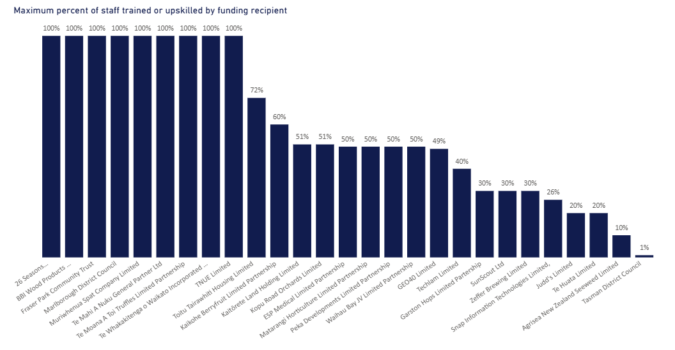
RSPF Impacts Reporting
Results to 31 March 2026
Results by Q&A type
27
organisations have trained or upskilled staff as a result of RSPF funding
9
Organisations trained or upskilled all their staff

